Slide 1
PONG USING VGA
Hannah Tandang, Jianzheng Ruan, Joey Sorkin, Jiaxing Wang
Group 3
Notes:
Jay

Slide 2
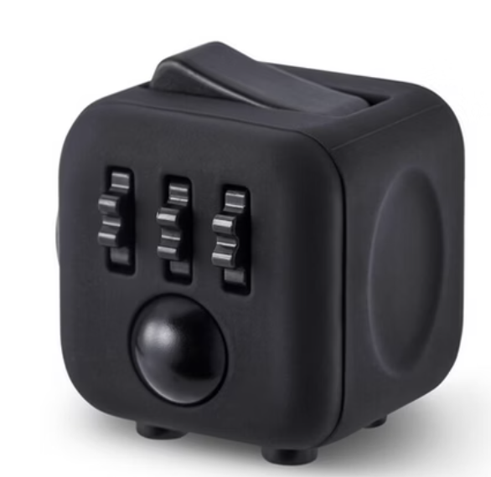
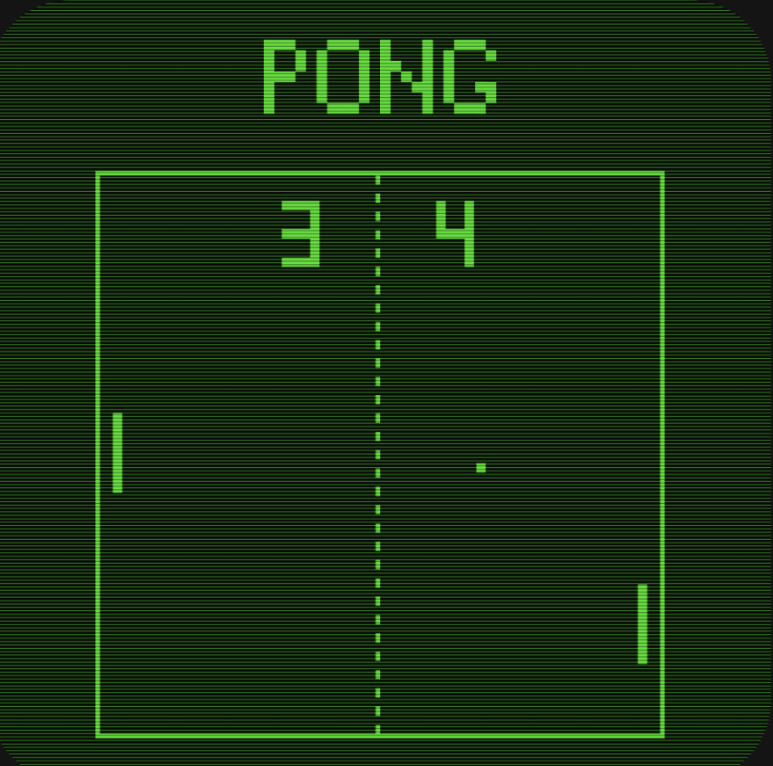
Goal/Motivation
Motivation
Entertainment during winter break using logic! :)
Implementing arcade games into FPGA for commercial use
Fidget toy using the FPGA board buttons and switches
Goal
Recreate Pong
Apply theory learned from labs and lectures
Clock divider (VGA 25MHz : FPGA 100MHz)
Binary operations
Finite state diagrams
Develop larger interactive systems on Verilog
Enhance problem-solving and debugging skills in HDLs
Notes:
Jay- Recrete the game of pong using verilog and FPGA board
Implement binary calculation to control ball velocity and positions
Use logics gates to check for collision with between the ball, paddles and the walls.
Top module to integrate separate module
State machine
Reuse clock divider from LAB to match VGA frequency and display frequency on screen. (4X difference: 25MHZ VGA VS 100 MHz FPGA)

Slide 3
Functionality
Game start: ball centered on screen, paddle on edges at screen_height / 2.
“Start” button pressed: ball moves, ball.v updates position by adding velocity.
While ball moving: detect ball collision with walls and paddles.
Colliding with top or bottom screen edge — ball bounces off wall
Colliding with left or right screen edge — opposing player scores, ball position resets to center
Colliding with paddles — x-velocity negates (two’s complement); y-velocity may be modified
Either player’s score reaches 4: game clock will stall.
“Reset” button pressed: Resets game state until ”start” button pressed.
Notes:
Jay

Slide 4
Design Requirements/Constraints
Implementation
Separate modules instantiated in top module → individual responsibilities + simpler debugging
Global variables to communicate
Requirements
2 player pong
able to move paddles
ball with changing velocity
displaying score and ending
Constraints
Monitor size & resolution
Inputs on FPGA board
Notes:
hannah

Slide 5
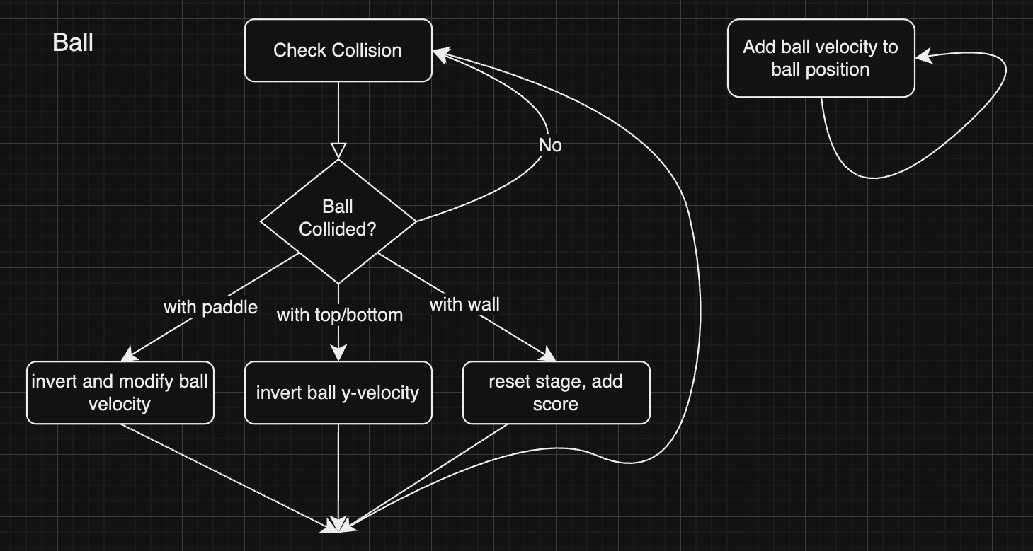
Block Diagram
Notes:
Joey

Slide 6
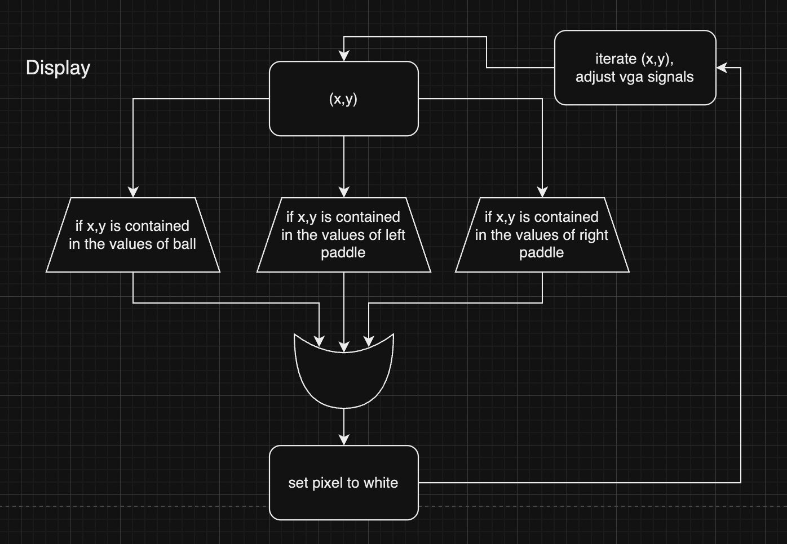
Block Diagram
Notes:
Joey

Slide 7
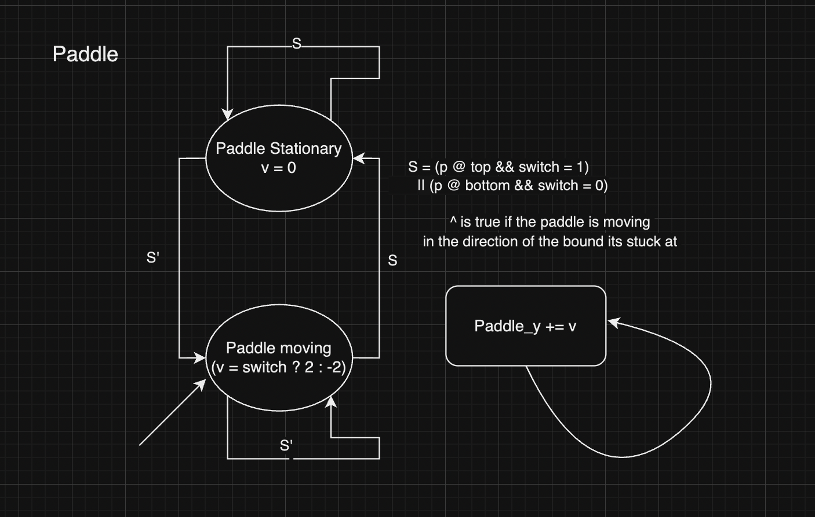
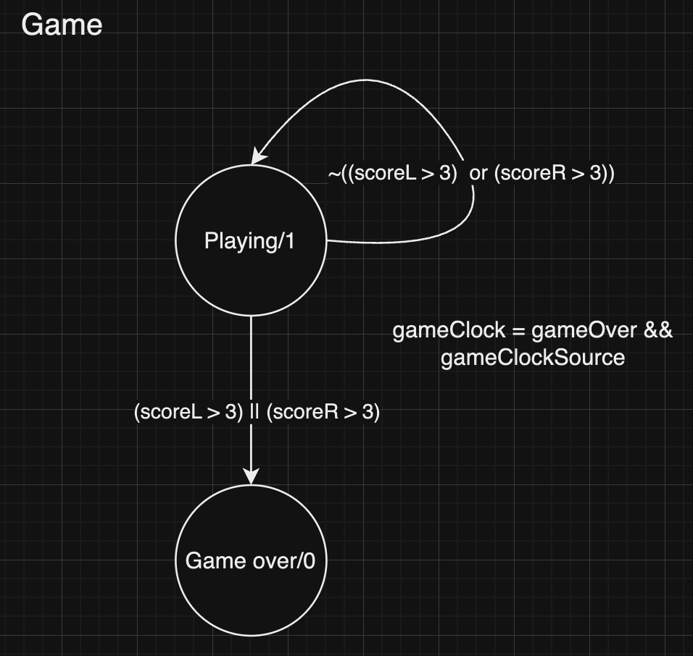
FSMs
Notes:
Joey
Mealy machine!!

Slide 8
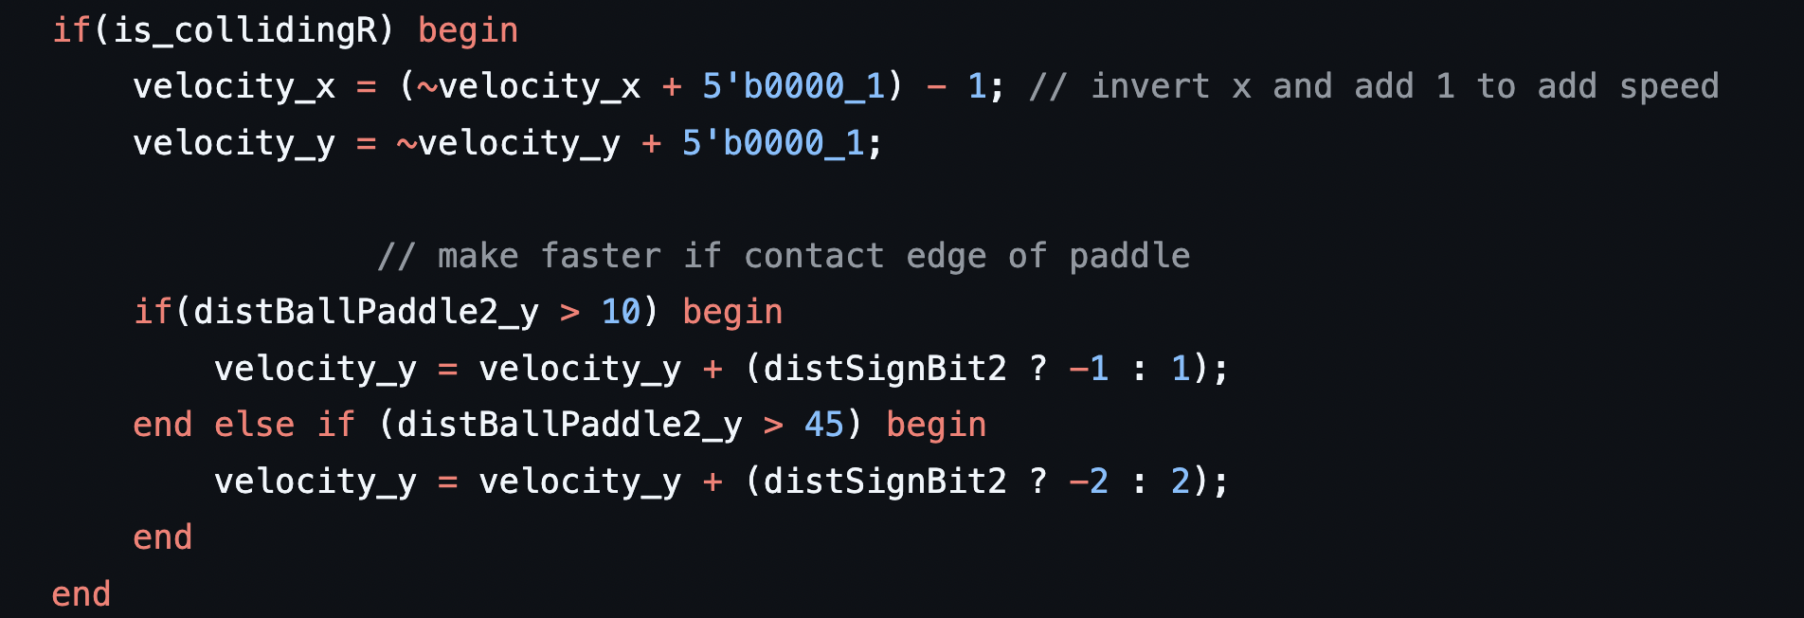
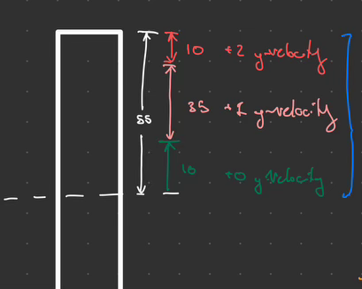
Code Snippet
Collision between the ball and the right paddle
Notes:
Jiaxing
Unique? Challenging? Innovative?

Slide 9
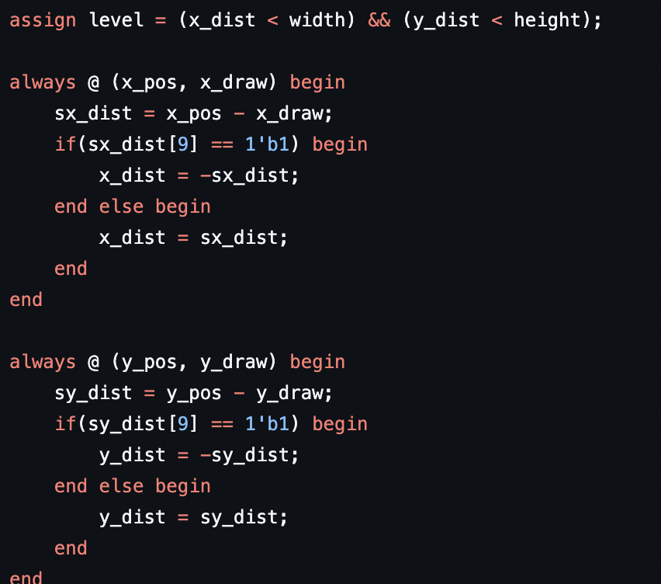
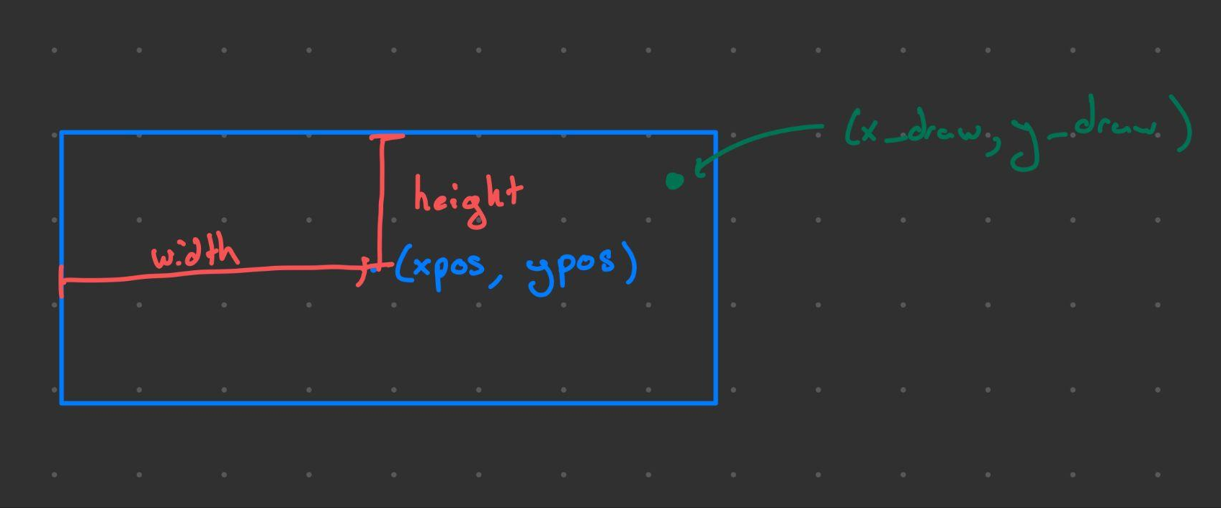
Code Snippet
Objects are generated by the rectangle.v module.
When the VGA is drawing a pixel within the bounds of this rectangle, level becomes true and the pixel is
set to white.
Notes:
Jiaxing
Unique? Challenging? Innovative?

Slide 10
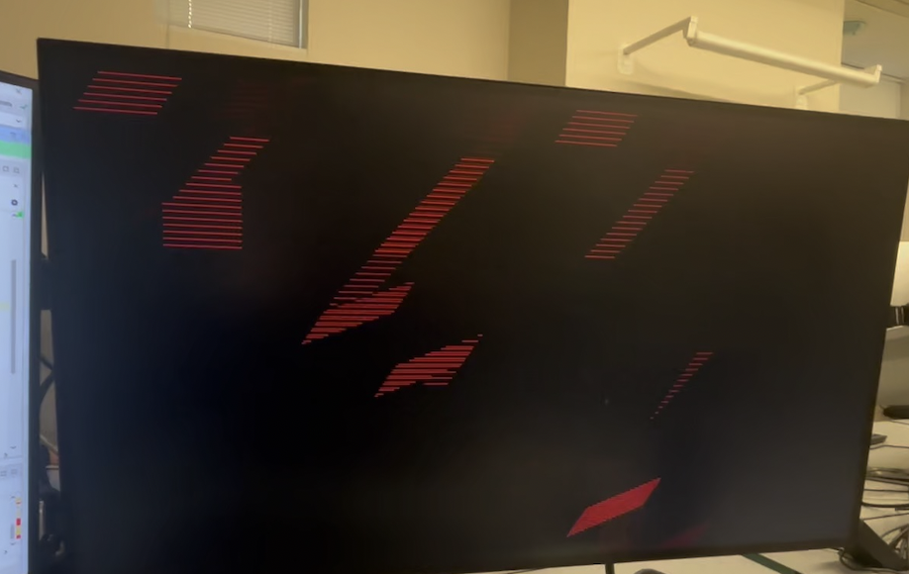
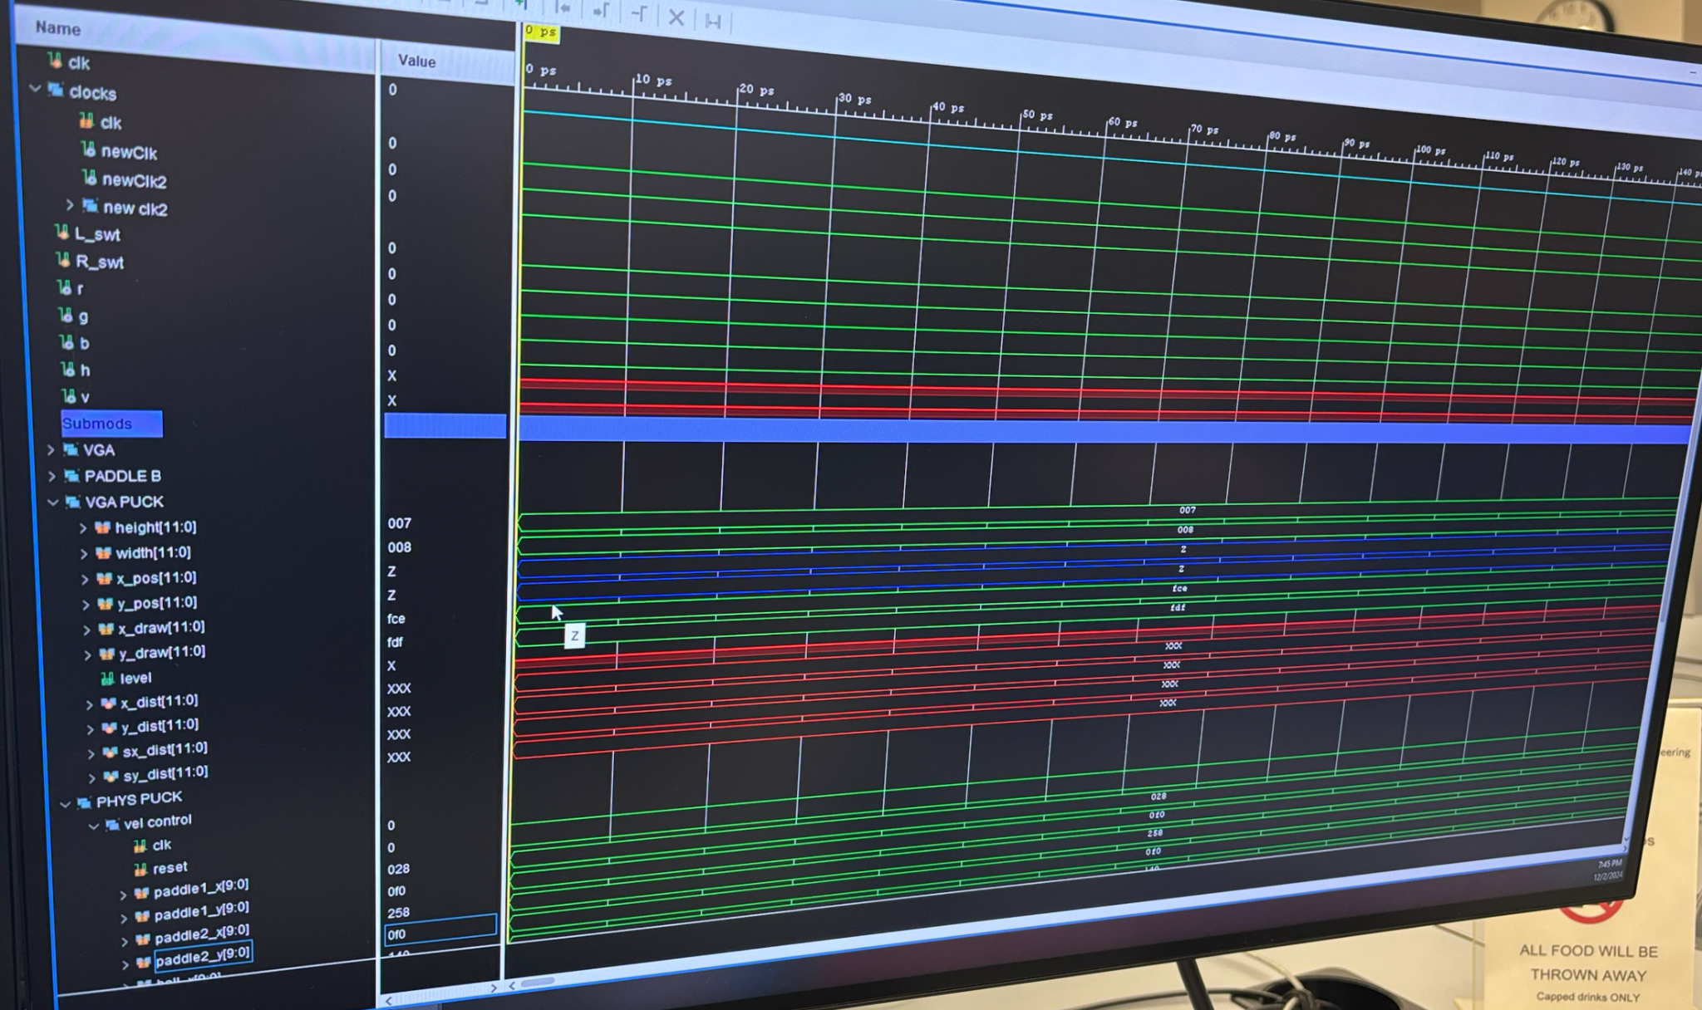
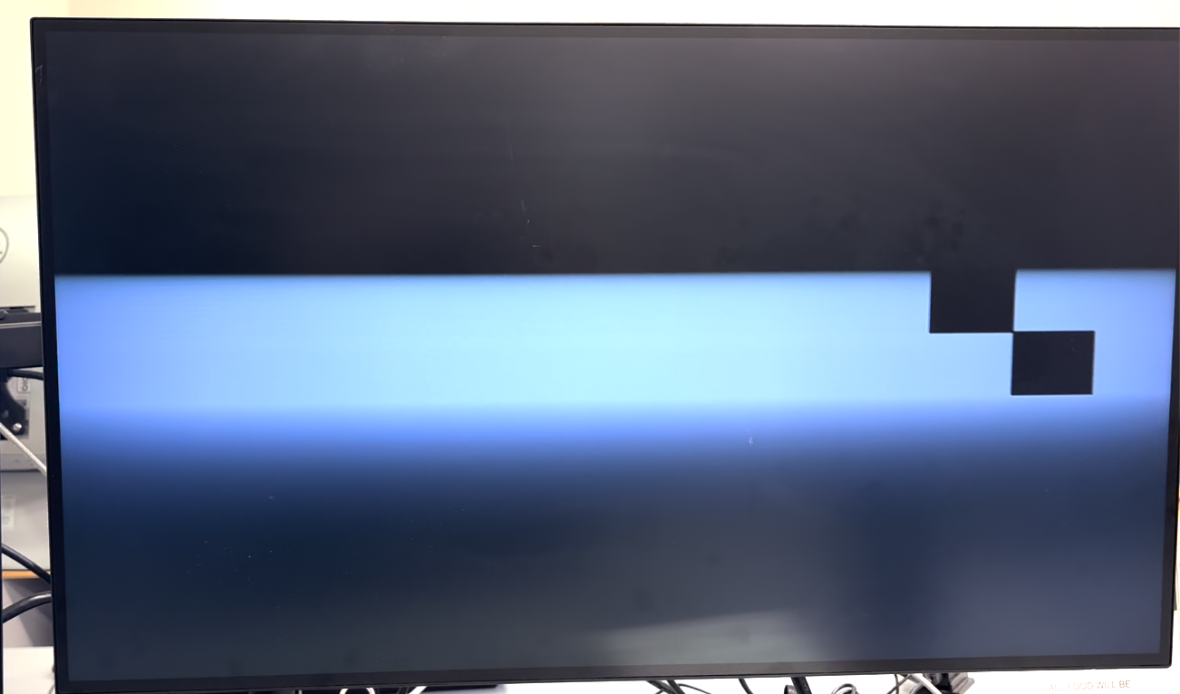
Early Testing
Notes:
Joey
Each module was tested on its own
Early stages, really hard to debug. - we forgot to standardize a lot of things across modules
Test benches were very chaotic but very helpful

Slide 11
Successes
Gameplay | Gameplay physics is unique and interesting while still being intuitive to play
Simulations | Proficient use of simulations to see number increments and logic changes
Integration | Successful integration of modules, with outputs of one module being inputs of other modules
Notes:
hannah

Slide 12
Challenges
Top Module Integration | Integration of all modules into top module
Velocity Subtraction | No standardization → Subtraction of numbers with different bit sizes, making two’s complement more difficult
Coordinates | Coordinates are slightly off on different monitors
Future Ideas
Sound effects
Better control of speed
Start and end screen
Single player mode
Improve score display
Notes:
hannah

Slide 13
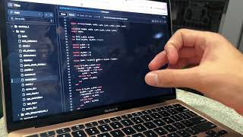
Gameplay

Slide 14
THANKS

